Slide 1
Welcome Class of 2027
Liberty High School
Home of the Lions

Slide 2
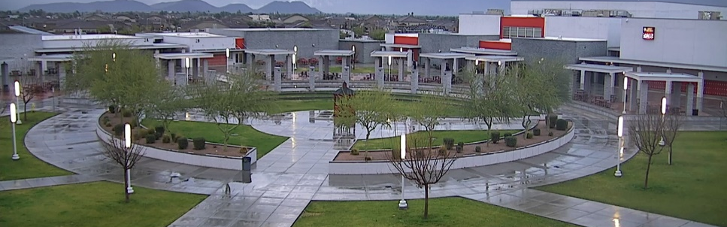
Name 1 thing you are looking forward to about High School?

Slide 3
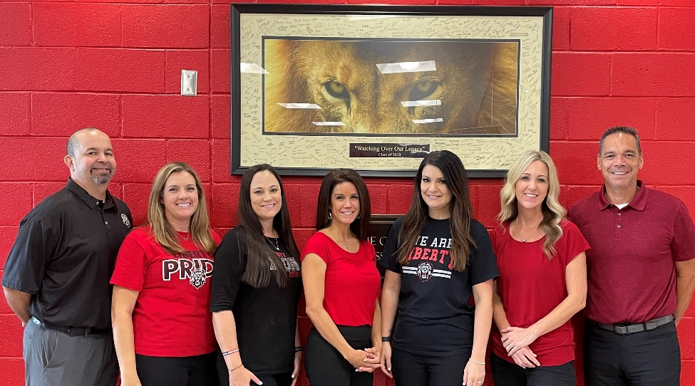
Liberty High School COUNSELORS
Mr. Babb
Mrs. Broening
Mrs. Johnson
Mrs. Hospelhorn
Mrs. Nuttall
Mr. Repak
Mrs. Walter

Slide 4
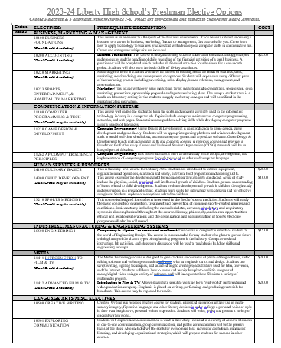
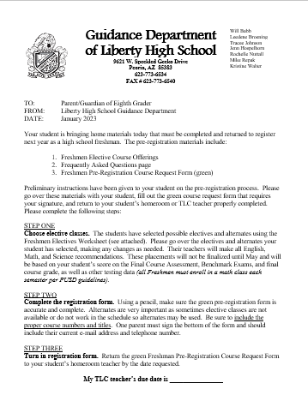
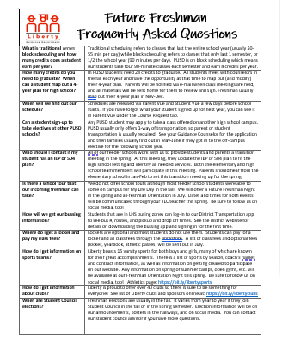
Take Home Packet
What is it?
Letter for your parents with information & deadlines.
Elective Options page
FAQ page
You will add your Green Pre-Registration Form to bring home to parents.

Slide 5
LeT’s talk about YOUR SCHEDULE!
- 9th graders can earn 8 credits and will be scheduled for 8 classes – 4 each semester!
- All Freshmen must take English, Biology, P.E., and two semesters of math!
- All 9th graders will take math both semesters.

Slide 6
So what does a High School
schedule look like anyway?
Is PE required???
Do all freshman have the same lunch?
Do my classes last the whole year?
Do I have to take Spanish I & II in the same year?
. . .

Slide 7
Sample Schedule A:
1st Semester -
1st hr. – Intro to Film
2nd hr. – Algebra I Yearlong
3rd hr. – Lunch
4th hr. – Biology
5th hr. – Mixed Choir
2nd Semester -
1st hr. – Marketing
2nd hr. – Algebra I Yearlong
3rd hr. – English I
4th hr. – Lunch
5th hr. – PE

Slide 8
Sample Schedule B:
1st Semester -
1st hr. – Algebra I Block
2nd hr. – PE
3rd hr. – Lunch
4th hr. – Biology Honors
5th hr. – Spanish I
2nd Semester -
1st hr. – English I
2nd hr. – Business Foundations
3rd hr. – Lunch
4th hr. – Spanish II
5th hr. – Geometry Honors

Slide 9
Pre-Registration Form
Your name and school have been filled in for you. Please complete the questions about siblings at LHS and write down any career interests.

Slide 10
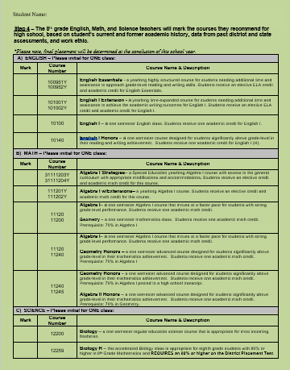
Core classes
Your teachers will recommend your English, Math, & Science classes based on your grades & previous test scores.
The placement CAN change at the end of the school year, so do your best work all year!

Slide 11
Personal Fitness
Step 1 – choose boys/girls PE, Marching Band, OR Dance.
Notes – If you don’t get dance due to it being full, we will automatically put you in PE instead.
ROTC (at cactus) is an option for your PE credit but you must choose a class here and then Apply to see if you get accepted. If you get in, we will swap it out later. SEE your TLC teacher for ROTC application.

Slide 12
Choose your ELECTIVE classes WISELY!
1. Choose what’s BEST FOR YOU! What are your career interests?
2. World Language classes are difficult and must be taken in consecutive semesters.
3. Listen to your Parents, Teachers & Counselor – they will help place you in the correct classes!

Slide 13
Step 2 and 3: Choose ELECTIVES & Alternates!!
Transfer top 6 electives to registration form in order of preference ~ include Course #’s

Slide 14
e-Campus Class Opportunity
Stay on campus & online class is part of school day
Work independently through the class & then use the rest of the time as a study hall.
FREE option if 1 of your 4 classes during school day (normally $300/class).
You can take many electives that are full/closed @ LHS this way.
Fill out GREEN pre-registration form AND fill out the e-Campus form & staple together and turn both in together on due date.

Slide 15
Join the Pride- Get Involved!!

Slide 16
Future Freshman SPORTS Information Night
Monday, 1/23 @ 6pm
Go to main gym for presentation
Meet coaches afterwards to get information on spring & summer camps.
Please write this date on the
front of your parent letter.

Slide 17
Finally… Take your GREEN Pre-Registration form home & bring it back with a parent signature! Due Date - __________

Slide 18
Make it a GREAT year!
Finish 8th grade strong!
Put forth your BEST EFFORT with grades & learning Study Skills!
Your academic placements can be changed thru 8th grade Promotion.
Attendance is very IMPORTANT!
We look forward to seeing you in the months ahead!

